Slide 1
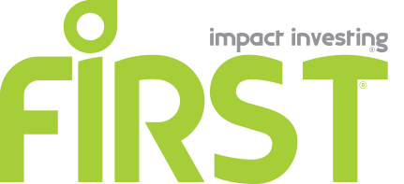

Slide 2
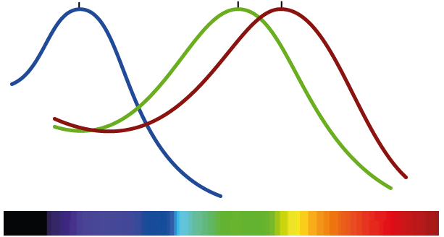
The Impact Investing Spectrum

Slide 3
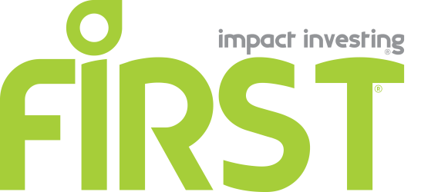
Who we are:
FIRST – Brazil Impact Investing Fund
focuses on Growth Equity
for Small and Mid-Size Enterprises,
of essential products and services,
with the ability to serve at least one million clients
of the Brazilian Base of the Pyramid.

Slide 4
What is our Impact Investment Thesis
social impact intrinsic, symbiotically connected to the corporate strategy of the business.
> Intent
Impact
Business <
> R.O.I.

Slide 5
Our Investment Methodology Summarized
Continuous Pipeline
Selection Criteria
FIRST
Entrepreneur and Team
Scalable Social and Environmental Impact
Growth BoP Business
Multiple Exit Opportunities
Innovation-driven
Growth SMEs
serving
BoP Households
Investment Analysis
Multiple Sources

Slide 6
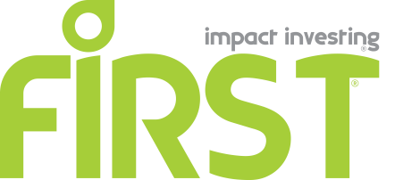
We perform a disciplined analysis of 14 Core Investment Vectors
Character
Commitment to the Business and to Social Impact
Competencies
Compatibility with the FIRST Team
Capacity to innovate
Customers, emerging consumers
Corporate Governance, Co-investors, Control Group
Chain (Value Chain)
Competition
Consolidation
CAGR
Cash Flow
Cash-out, exit strategies
Contractual conditions

Slide 7
A revolution to save capitalism from the capitalists in under way ^{(*)}
Adam Smith, the moral philosopher, alerted to the damaging effects mercantilist and other interventionist policies have on the poor.
Friedrich Hayek called social justice a mirage.
John Rawls conceptualized freedom and equality as seamless with justice as fairness.
Rawls and Hayek agree on "the essential point," that principles of justice apply to the RULES of institutions and social practices, but not to distributions of particular forms of wealth across specific persons.^{(*)}
The current revolution is to bring capitalism back to its essence.
GDP
POPULATION
Poverty
Distribution of Wealth
Source: The Economist (March 15th 2014) and Andrew Lister, The ‘Mirage’ of Social Justice..., Oxford U. May 2011

Slide 8
How can capitalism contribute to Catholic-inspired Social Development?
GDP
Evangelii Gaudium is an Ignatian view of God everywhere, in people, places and trends.
Evangelii Gaudium calls for rethinking the way every person or every institution recycles wealth latu-sensu - i.e, everything one owns "in excess”, materially, moral values, or one’s spirituality.
The heart of the Christian message is love for one another, and work for social justice.
That is how...
POPULATION
Poverty
Wealth Distribution

Slide 9
THANK YOU
Marcus Regueira
marcus.regueira@firstimpact.com.br +55 31 3074.0020
Maria Cavalcanti
maria.cavalcanti@firstimpact.com.br +1 917 304 4564

