Slide 1

Smallholder Businesses in Nicaragua
Vatican Session: Investing for the Poor
16 June 2014

Slide 2

Inspired by Impact

Slide 3
Observations from the Field
Equity exits are difficult to achieve in base-of-pyramid markets
For micro-enterprises, access to capital remains stubbornly difficult or too expensive
Involvement by local banks requires a pledge of substantial assets (that the poor do not have)
Capacity development needed at *every stage*

Slide 4
Dividend from gender lens

Slide 5
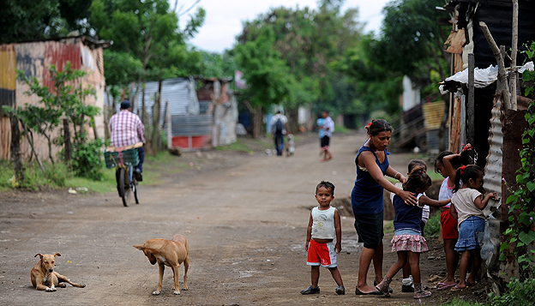
Variable Payment Obligation
(Demand Dividend)
…Bringing financial inclusion to women-led businesses
Image courtesy of Madre

Slide 6
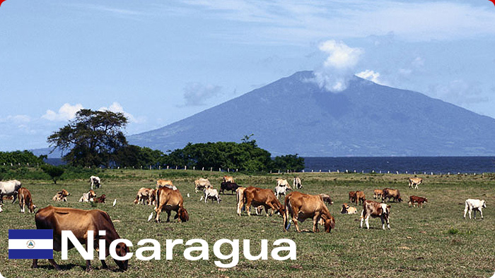



BAC Variable payment obligation trust
$600,000 pool of capital for the pilot stage
$25,000 - $50,000 loan size
Focusing on women-led businesses
  51% owners or principal managers
  Average $150K annual revenue in Nicaragua
5-year term
Target IRR is 10% - 15%
Screening done by Agora and BAC
VPO is a Demand Dividend structure
Image courtesy of Madre

