Slide 1

Investing in action:
Microinsurance
The 2014 Vatican Impact Investing Conference
Michael Fernandes, LeapFrog Investments, June 2014

Slide 2
The need for financial services is significant
Worldwide, billions of emerging consumers are seeking financial services to help them rise out of poverty
3.6 Billion
people worldwide
earning between
PPP $1.25 & $10 per day
1.9 Billion
of these people
are in Africa
and S&SE Asia
70%
have no access to
financial services
(11% in developed markets)
NOTE: All data is based on Sab-Saharan Africa, South Asia and Southeast Asia excluding China; Population and household consumption data is
based on income between $2-$10/day PPP; Financial access data is based on all income levels;
SOURCE: World Bank WDI, GEP and Global Findex (2012); LeapFrog analysis

Slide 3
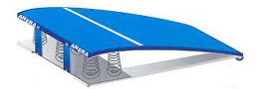
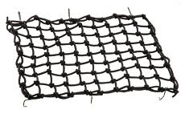
Financial services can create a pathway out of poverty
Safety nets and springboards in action
With financial services, people can increase income and build a future
Springboards
Safety Nets
Without financial services, a constant cycle of poverty

Slide 4
LeapFrog is a global leader in Profit with Purpose investing
LeapFrog invests in companies that deliver both financial and social returns
Profit with Purpose
Emerging consumers
Our focus is the 1.9 billion low-income people in Africa and South & Southeast Asia
Operational expertise
We build companies by providing technical skills
Safety nets & springboards
We invest in companies that offer affordable insurance and savings products
Solutions at scale
We invest in high-growth companies that reach millions of people
Rigorous measurement
We measure performance, and drive our companies to achieve social and financial goals

Slide 5



AllLife: Insurance for the uninsurable
6 million patients with HIV/AIDS in South Africa: previously, no access to insurance
AllLife the first to provide life assurance, combined with life-style management and regular health checks.
85,000 people have already benefited
Innovative and caring customer support system
Now being rolled out to diabetics
Insurance in action: Mzi P, South Africa
HIV+ male; approved for home loan pending life insurance
Declined at bank due to HIV+ status
AllLife provided life insurance
Home loan approved next day
Now enjoying new home and AllLife’s regular health check ups

Slide 6
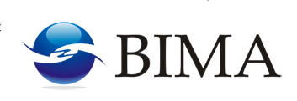

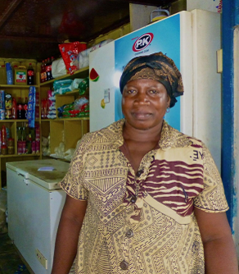
BIMA: Technology to reach the unreachable
Low-income consumers often cannot access insurance through traditional channels
However, penetration of mobile phone ownership is high
Insurance for low-income customers via mobile, premiums from $0.24 a month
4.9 million people reached with active insurance policies
Insurance in action: Lydia Larbi, Ghana
  Worked at convenience store for 17 years
  Widowed; used insurance to protect and build her store
  Found Bima’s mobile claims process simple
  Covered for US$2.50 per month
  Sees value of insurance: registered son to policy

Slide 7
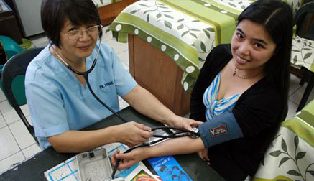
Lessons from Profit with Purpose in action
It is possible to provide financial safety nets and springboards to millions of vulnerable people
The key is to offer the right products through the right channels in a manner that can be repeated and scaled
How can the Church, with its massive scale, help us reach more under-served people?
Spotlight on The Philippines
4 million diabetics today; 7 million by 2030
Life and health coverage costs rising significantly
Life expectancy and quality of life affected; the poor are most impacted as no coverage
Can the Church create quarterly check-up facility and diet support to enable affordable insurance provision and bring down burden of diabetes for the ‘Pinoy’?

