Slide 1

Investing for the Poor: How Impact Investing Can Serve the Common Good in the Light of Evangelii Gaudium
June 16-17 2014
Investing for Impact
in African Healthcare

Slide 2

The ELMA Group of Foundations
Missions
The ELMA Foundation’s mission is to improve the lives of Africa’s children
and youth through the support of sustainable efforts to relieve poverty, advance education and promote health.
The ELMA Vaccines and Immunization Foundation’s mission is to expand vaccine and immunization coverage for children globally.
The ELMA Relief Foundation’s mission is to provide post-disaster emergency assistance throughout the globe with special attention to the needs of children, who often suffer disproportionately in the aftermath of such tragedies.
The ELMA Music Foundation’s mission is to provide philanthropic assistance to organizations in South Africa, the UK and the USA that either provide music education to underprivileged children and youth or provide assistance to members of the music community who undergo personal and financial hardship.
The ELMA Growth Foundation’s mission is to improve the economic and/or social development of low income individuals, families or communities.
The ELMA South Africa Foundation funds selected programs not aimed specifically at children, within the country of South Africa.
6
www.elmaphilanthropies.org
Notes:
ED STRATEGY

Slide 3



Why Healthcare is Still Important
IN JUST ONE YEAR
290,000 women and girls die in childbirth
99% of these in developing countries
6.6 million under 5’s die of preventable diseases
>90% in developing countries
2.9 million newborn deaths constitutes 40% of under 5 deaths
2.6 million stillborn NOT counted in 0-5 Health Statistics
5.5 million per year / 15,068 per day / 10 per minute
9
www.elmaphilanthropies.org
Notes:
ED STRATEGY

Slide 4
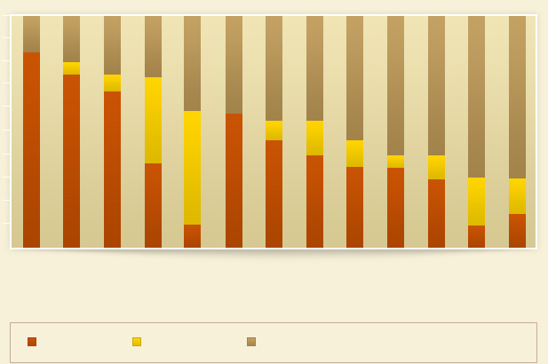
Private Sector Health Spend in Africa
Private versus Public Expenditure on Health
100%
90%
80%
70%
60%
50%
40%
30%
20%
10%
0%
Percentage
Nigeria
Guinea
Uganda
South Africa
Ghana
Kenya
Ethiopia
Tanzania
Rwanda
Namibia
Cote D’Ivore
Zambia
Mozambique
Private OOP Private Other Public
Private OOP = Private Out Of Pocket
Data: IFC Business of Healthcare report 2007
12
www.elmaphilanthropies.org
Notes:
ED STRATEGY

Slide 5
Investment Case for Private Healthcare
NYSE
P:E ratios
JSE
P:E ratios
14
Data as of May 2014
www.elmaphilanthropies.org
Notes:
ED STRATEGY

Slide 6
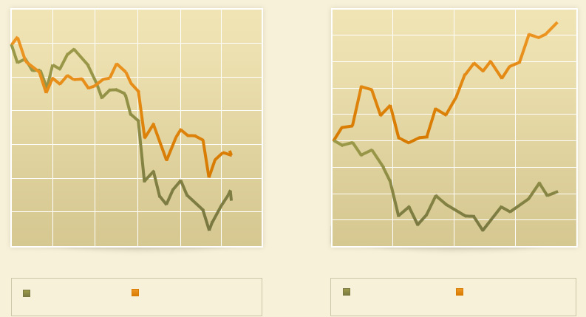
Healthcare Sector is Defensive
50%
40%
30%
20%
10%
0%
-10%
-20%
-30%
-40%
NYSE Health Care Sector Index
Jan 2008 – April 2009 Performance
SA Health Care Index:
July 2008 - July 2009 Performance
10%
0%
-10%
-20%
-30%
-40%
-50%
60%
Jan-12 Apr-1 Jul-12 Oct-12 Jan-13 Apr-13
Jun-12 Sep-12 Dec-12 Mar-13 Jul-13
NYSE Composite
NYSE Health Care
Sector Index
JSE All Share Index
SA Health Care Index
17
www.elmaphilanthropies.org
Notes:
ED STRATEGY

Slide 7
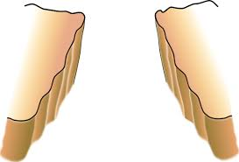
Funding Gap
$$$
Government, donors
churches
$$$
Private equity
Public companies
Public sector
Faith based not for profit
For profit
servicing wealthy
NGO
$?
Private practices
SMME
(aka small, med, micro enterprises)
Social enterprise
No financial return
Unsustainable!
High financial return
Some financial return
22
www.elmaphilanthropies.org
Notes:
ED STRATEGY

Slide 8
Impact Investment Framework
26
www.elmaphilanthropies.org
Notes:
ED STRATEGY

Slide 9


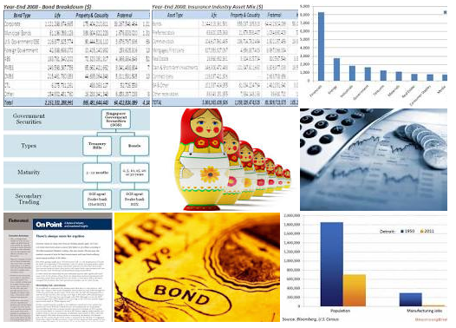

Investment Examples
Private Companies
Debt Funds
Social/Development Impact Bonds
Private Equity Funds
28
www.elmaphilanthropies.org
Notes:
ED STRATEGY

Slide 10

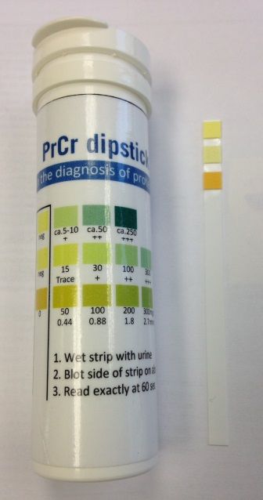

Debt/Equity - POC Diagnostics
NEED:
Reduce wait times from days to less than an hour
Community health worker or nurse administered
Focus on disease burdens in the developing world
Affordable diagnostics
FINANCE GAP:
Capital available for research
High impact products stuck in research and/or mid-stage clinical trials
Insufficient ROI to warrant expansion of many and distribution capacity
30
www.elmaphilanthropies.org
Notes:
ED STRATEGY

Slide 11

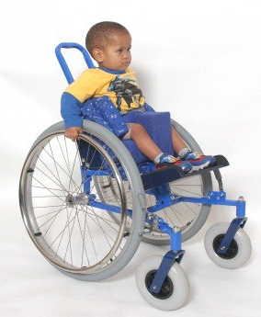
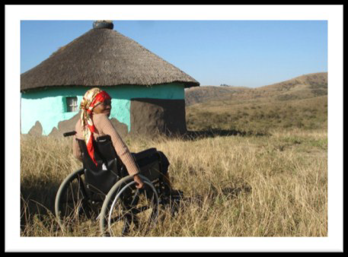
Debt/Equity - Wheelchairs for Africa
NEED:
Good quality contextually relevant products
Rugged and robust due to terrain needs
Affordable
Easy to repair / locally accessible parts
FINANCE GAP:
Many donations of equipment
Current equipment designed for first world conditions
Different sizes (pediatric implications)
Company who locally manufactures and distributes
33
www.elmaphilanthropies.org
Notes:
ED STRATEGY

Slide 12
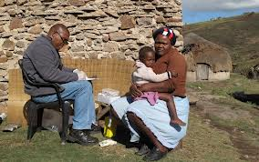
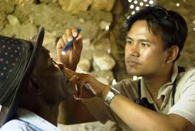

Development - Private Practice
NEED:
Better quality control and licensing
Broader access to financing (bonds, debt, equity)
Better access to equipment and new technologies
Need for expanded facilities
FINANCE GAP:
Quality enhancement tools and techniques
Increased patient purchasing power (risk pooling/health insurance)
Affordable loans
Small scale equipment financing
Professional development, quality
36
www.elmaphilanthropies.org
Notes:
ED STRATEGY

Slide 13
Private Equity Fund: Africa Health Fund
Overview
Investment Criteria
Fund Size: USD105 million
Year Founded: 2009
Location: UK
Description: The Africa Health Fund is managed by Aureos Capital. Aureos aims to align interests, support strong corporate cultures and combine global best practices with local expertise in its investments.
Target Investment Size: USD250,000-USD5 million
Stage: Growth
Industry Focus: health services, distribution and retail, life sciences, risk pooling and medical education
Other: Significant impact on health for the base of the pyramid (defined as less than USD3,000 in income per person)
Geographical Focus
Representative Investments
Nairobi Women’s Hospital, Kenya – Woman-focused hospital
C&J Medical, Ghana - General hospital
Revital Healthcare, Kenya - Syringe manufacturer
Avenue Group, Kenya - Primary healthcare, integrated managed care, general hospitals
The Bridge Clinic, Nigeria - Reproductive services
La Clinique Biasa S.A., Togo - General hospital
Vine Pharmaceuticals, Uganda - Retail pharmacy chain
Aninwah Medical Centre Limited, Ghana - Primary healthcare clinic with some secondary in-patient care
Steripharma, Morocco - Pharmaceuticals manufacturing
Data summarized from Fund Manager Abraaj year-end report 2013
39
www.elmaphilanthropies.org

Slide 14
Why Invest. Why Now.
ELMA, CRS and other FBOs are uniquely placed to advance early stage investment in businesses that can help achieve mission objectives
Structure allows flexibility in funding
Involvement in grant-making for health and education provides insight into social and market gaps
Strong, contextually relevant legal, health, education and investment expertise derived from our grant making
Back office infrastructure largely in place to oversee these investments
The ultimate goal is to explore investments that leverage market-driven businesses to increase the underserved access to health
41
www.elmaphilanthropies.org

Slide 15
Challenges
Measuring Impact
  Quantifying social benefit and determining its worth in terms of forgone return can be hard
  Some social investing benefits are indirect
Balancing Social and Financial Return
  Investments that would be financial “failures” may still be social successes
  Social businesses struggle to reach the very poor and most needy
  Without discipline investees may favor returns over social objectives
Sourcing Promising Social Businesses
Structuring Investments that capture the Benefits of Market Incentives while encouraging Social Impact
Realizing Successful Exits
  Impact investing remains in its infancy and few funds have made significant successful exits
  A successful exit should realize financial return and ensure continued focus on the social mission
45
www.elmaphilanthropies.org

Slide 16
Opportunity
Provide equity or debt to push early stage health and education businesses from proof of concept to profitability
Concept
Development
Revenue
Profitability
Growth
Scale
Incubators
Opportunity
Social and Traditional PE
48
www.elmaphilanthropies.org

Slide 17
Structure Overview
Model | Summary | Advantages | Challenges
In-House Fund | Fully owned and controlled entity Managed from in-house offices Utilizes grant making back office Small dedicated staff | High involvement for staff Potential to catalyze overlooked businesses Ability to tailor financial/social return mix Flexible capital structures Control over impact areas | Organizational costs Attracting talent Key person risk
Outsourced Management | Use 3rd party management Investor review and approval Investor oversight | Access 3rd party expertise Lower in-house HR burden Potential to catalyze overlooked businesses | Less control for investor Higher transaction costs Balancing social and financial return may be more difficult
Strategic Co-Investment | Builds on current relationships Selective co-investment positions Diligence and structuring by co-investor | Low sourcing costs Low transaction costs Leverage partner expertise Most applicable to individual investment rather than pooled vehicles | Smaller investment universe By definition investing in organizations with access to other capital More difficult to target early stage businesses
51
www.elmaphilanthropies.org

Slide 18
Next Steps
To identify and quantify direct investment models
Evaluate one’s mission – essential obligations (Mission First)
Refine market gap analysis
Determine potential deal flow
Research feasibility of investment models
Define resource requirements
INVEST
53
www.elmaphilanthropies.org

