Slide 1
The Aga Khan Development Network and Impact Investment
Investing for the Poor:
How Impact Investing Can Serve the Common Good
in the Light of Evangelii Gaudium
June 17, 2014
Vatican City
Presenter: Dr. Mirza Jahani, CEO, Aga Khan Foundation U.S.A.

Slide 2
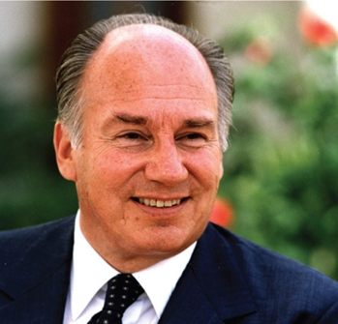
The Power of Impact Investing
“I believe that impact investment is one of the most important concepts that I can recollect in the last 50 years. And the reason is that it harnesses social ethic to economic purpose.”
- His Highness the Aga Khan, October 22, 2012, in acceptance of the David Rockefeller Bridging Leadership Award

Slide 3
AKDN Agencies and Institutions

Slide 4
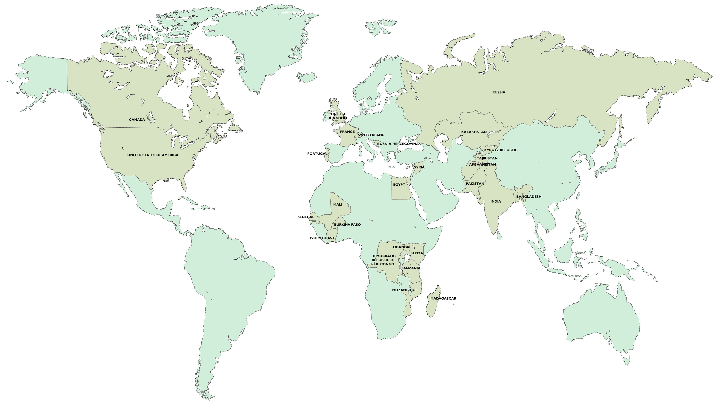
Where AKDN Works

Slide 5
Ethical Framework
The AKDN is a contemporary endeavor of the Ismaili Imamat to realize the social conscience of Islam through institutional action
While personal morality is paramount, the function of ethics is to foster self-realization through giving of one's self, for the common good, in response to God's benevolent majesty
Institutions of the Network derive their impetus from the ethics of Islam which bridge the two realms of the faith, din and dunya, the spiritual and the material

Slide 6
Collaboration with the Catholic Church
2005 - Partnership Agreement between the Aga Khan Foundation and the Patriarchate of Lisbon
Renewed in 2012 as a shared commitment to continually invest in promoting pluralism and the development of civil society as critical factors in the wellbeing and progress of societies.
2008 - MoU between the Aga Khan University (AKU) and the Catholic University of Portugal
Renewed in 2013 to foster and strengthen academic collaboration in pursuit of both Universities common goal of equitable human advancement.
The Cardinal Patriarch of Lisbon, His Eminence Dom José Policarpo, and Prince Amyn Aga Khan sign the renewed partnership agreement between the Patriarchate of Lisbon and the Aga Khan Foundation to improve the quality of life of marginalized groups in Greater Lisbon, as the Portuguese Minister of Solidarity and Social Security, Pedro Mota Soares and the AKDN Resident Representative for Portugal, Nazim Ahmad look on.

Slide 7
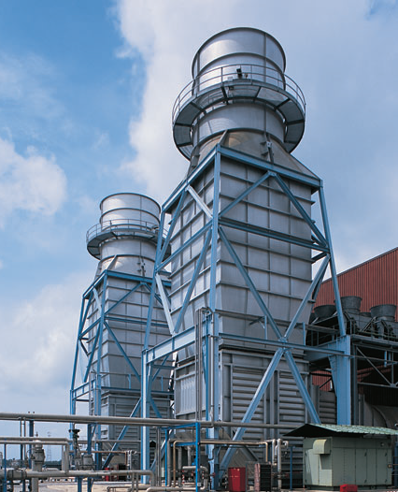
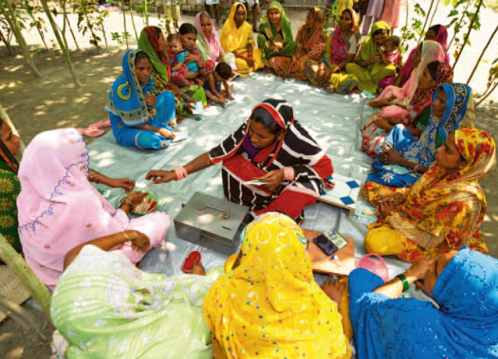
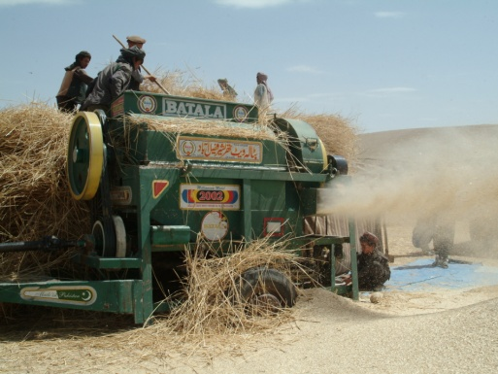
Investment Approach
Goal: To improve quality of life through local, permanent institutional development
Large Scale
More Revenue Generation
Large Scale
Less Revenue Generation
Small Scale
Less Revenue Generation
Small Scale
More Revenue Generation
SOCIAL ENDEAVOR

Slide 8
Investment Approach
Goal: To improve quality of life through local, permanent institutional development
Large Scale
More Revenue Generation
Large Scale
Less Revenue Generation
Small Scale
Less Revenue Generation
Small Scale
More Revenue Generation
SOCIAL ENDEAVOR
Global Commercial Investment
Blended Finance
Asset Building
Local Blended Investment
INVESTMENT TYPE

Slide 9
Aga Khan Fund for Economic Development
Guided by AKDN’s ethical framework, AKFED builds enterprises in parts of the world that have potential for growth and employment creation.
Investment decisions are based both on the ability to improve people’s lives in fragile and complex environments and on bottom-line profitability
Examples: Azito Power Station; Pamir Energy; Serena Hotels; Nation Media Group; Kyrgyz Investment and Credit Bank; Ivoire Coton
Large Scale
More Revenue Generation
Global Commercial Investment

Slide 10
Blended Finance: Institutional Development
Identify private social sector institutions where fee-for-service is great enough to expand and cross-subsidize improvement to quality of life
Use a combination of grants and impact investment / Mission Related Investment to leverage additional capital to speed expansion
Examples: Aga Khan University Hospital Expansion-Karachi; Aga Khan Academy-Maputo; Nairobi City Park; University of Central Asia-Khorog Campus; Aga Khan Agency for Microfinance
Large Scale
Less Revenue Generation
Blended Finance

Slide 11
Sustaining Social Services
Small Scale
Less Revenue Generation
Many people cannot afford commercially sustainable services (e.g. Base of the Pyramid, those suffering from humanitarian crises)
Cross-subsidize service provision from more profitable enterprises, while building a variety of local assets for long-term sustainability
Examples: Community Philanthropy; AKUH Patient Welfare Fund; ECD Center Endowments; Real Estate
Asset Building

Slide 12
Future Directions: Local Investment
Small Scale
More Revenue Generation
Create regional funds or investment companies that are “permanent and localized”
Integrating and deepening financial services
Build local capacity through academic education; training; local hires; and knowledge transfer
Local Blended Investment

Slide 13
Innovative Partnership: USAID MIAD GDA
Investment Vehicle
Trust Mechanism
MIAD financing facility set up
Financing facility invests in economic drivers
Economic drivers return a profit
Portion of financial returns into a nonprofit
Nonprofit disburses funds for social development
Global
Development
Alliance
Governance
Toward
Sustained Social & Economic Development
Platform for Social Development
Education
Health
Rural Development
Microfinance
Year 1
2
3
4
5
6
……
20

Slide 14
Future Directions: Pooled Capital
Creates more flexibility and efficiency in the deployment of the ‘right’ type(s) of capital to each project/enterprise
Pooled Vehicle (Fund; Holding Company; SIB/DIB)
Grants
Private Equity
AKDN and Partner Entities
Commercial Business
Local Civil Society
Beneficiaries
Entrepreneurs
Women
Institutional Investment
Debt
Health and Education Institutions
Social Enterprise
Future Local Leaders
Base of the Pyramid

Slide 15
AKF USA Portfolio Overview
Deal | Deal Status and Type | Co-investors /Partners | Impact
First MicroFinance Bank of Afghanistan | Closed Equity | AKAM, KfW, IFC, AKF USA | Expand the provision of financial products such as SME loans in Afghanistan
Aga Khan University Hospital, Karachi | Closed Debt | OPIC, AFD, AKF USA, AKHMCF | Increase access to healthcare and medical education in Pakistan
Aga Khan Academy, Maputo (similar investment in AKA - Dar & Dhaka) | Ongoing Debt | OPIC, AKF USA, AKES | Increase access to quality primary and secondary education in Mozambique
Nairobi City Park Service Company | Ongoing Blended | Ford Foundation, AKF USA, Tiffany & Co. Foundation, AKTC | Revitalization of a green space in the heart of Nairobi city to preserve ecological integrity and provide social and economic benefits to the local community
University of Central Asia, Khorog Campus (similar investment in Naryn & Tekeli) | Ongoing Debt | OPIC, AKF USA, UCA | Provide access to quality higher education and promote regional development in Central Asia
MIAD-Afghanistan | Ongoing Debt or Equity | AKFED, AKF USA, USAID | Regional pipeline of enterprises, with a portion of profits to a Trust for Badakhshan Province.

Slide 16
Questions?

